Slide 1
How can we increase revenue
from
Catch the Pink Flamingo?
ANDRES COSME MALASQUEZ

Slide 2
Problem Statement
● In order to increase the revenue generated by the game “Catch The Pink Flamingo”, we need three subjects of datasets.
● In the first one, "flamingo-data”, it contains 8 CSV files containing simulated game data and log data for the Catch the Pink Flamingo Simulated Game Data. These data will be used for data exploration in Splunk.
● The “combined-data” contains a single CSV file created by aggregating data from several game data files. It is intended to be used for identifying big spenders with KNIME.
● “chat-data” contains 6 CSV files representing simulated chat data related to the Catch the Pink Flamingo game to be used in Graph Analytics withneo4j
Notes:
Fill in appropriate/key data set descriptions.
In your script, be sure to make clear how this is a data science story. State in your own words YOUR opinion of why the different kinds and sources of data are so important for Eglence to be able to identify new revenue opportunities.

Slide 3
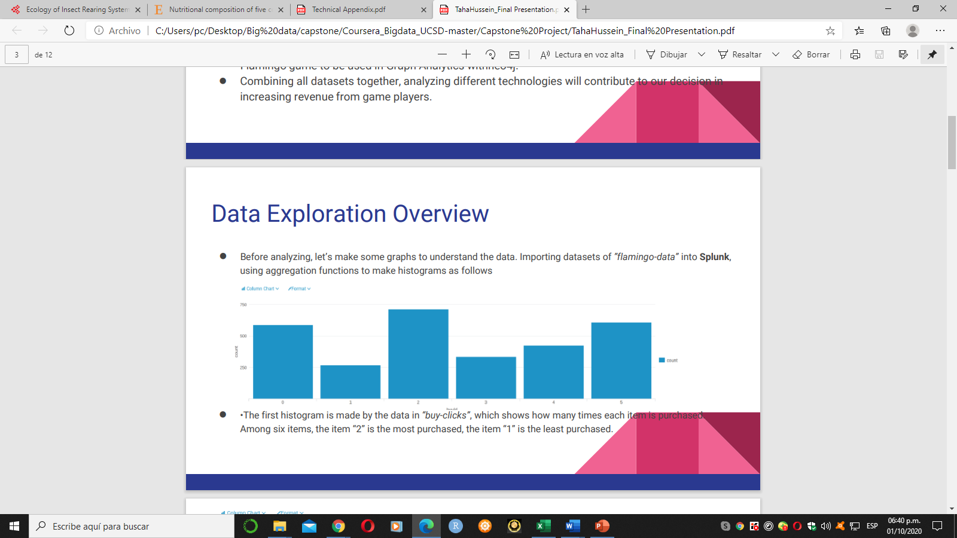
Data Exploration Overview
● Let’s make some graphs to understand the data. Importing datasets of ”flamingo-data” into Splunk, using aggregation functions to make histograms as follows
● •The first histogram is made by the data in “buy-clicks”, which shows how many times each item is purchased. Among six items, the item “2” is the most purchased, the item “1” is the least purchased.
Notes:
Assuming you have <2 minutes for this slide, what is the most important thing(s) to convey from your experience with exploring the data?

Slide 4
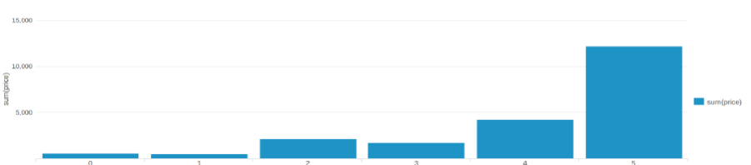
What have we learned from classification?
● The second one is made by the same dataset. According to this graph, we get different amount of money that made from each item. Among them, the item “5” made the most money, and the item “1” made the least money, which is also the least purchased, it means the item “1” is not preferred by most people. In this case, providers should think about strategies to change this situation or to solve this problem.
Notes:
Assume you have 2 minutes to present what you perceive to be the most important or remarkable points from your classification analysis.

Slide 5
What have we learned from clustering?
first method, we used “combined-data”, and classified users with Decision Tree in KNIME to identify big spenders in the game. The objective is to predict which user is likely to purchase big-ticket items while playing game. Using this file “combined_data”, we defined two categories for price: HighRollers, who spend more than $5.00 to buy the items, and PennyPinchers, who spend $5.00 or less to buy the items. In this graph, red stands for the PennyPinchers, blue stands for the HighRollers.
Notes:
Assume you have 2 minutes to present what you perceive to be the most important or remarkable points from your classification analysis.

Slide 6
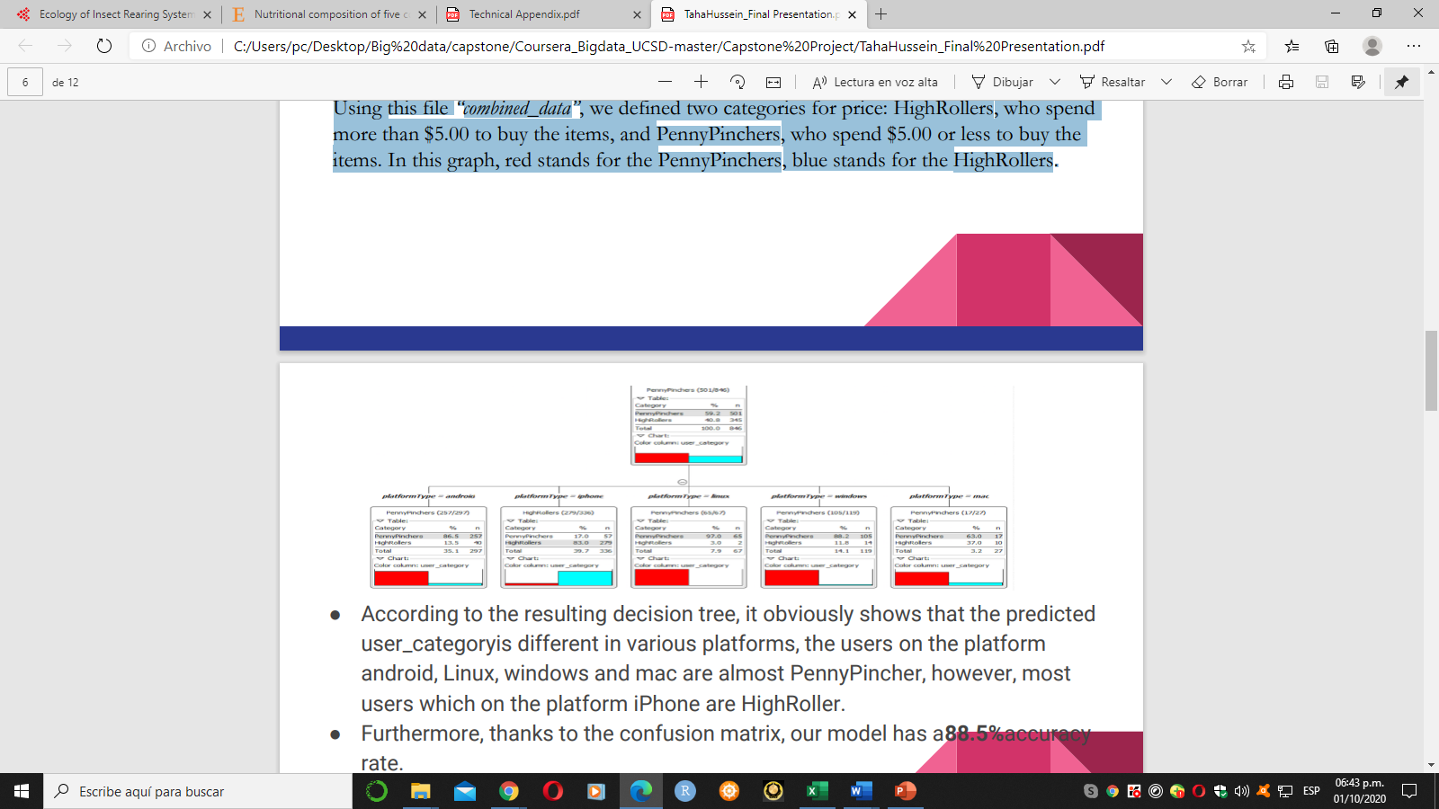
● According to the resulting decision tree, it obviously shows that the predicted user_categoryis different in various platforms, the users on the platform android, Linux, windows and mac are almost Penny Pincher, however, most users which on the platform iPhone are HighRoller.
● Furthermore, thanks to the confusion matrix, our model has a88.5%accuracy rate

Slide 7
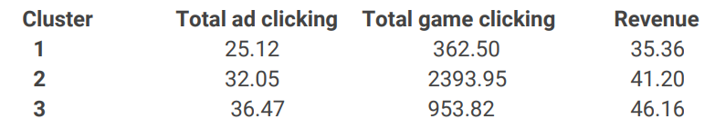
What have we learned from clustering?
● In this part, the Clustering method is applied, which is completed in iPython Notebook with Spark MLlib.
● Before beginning, I chose 3 attributes: amount of ad-clicking per user, amount of game-clicking per user and total price spent by each user. Then training data set is created by combining the 3 attributes in a table. Finally, training to create cluster centers and getting the following results.

Slide 8
● Cluster 1 is different from the others in that the users’ ad-clicks, game-clicks and cost are all less than others, this kind of users can be called “low level spending user”.
● Cluster 3 is different from the others in that the users’ ad-clicks, game-clicks and cost are all more than others, this kind of users can be called “high level spending user”.
● Cluster 2 is different from the others in that the ad-clicks is not the least, game-clicks is the most but their cost is not the most, this kind of users can be called “neutral user”.
● The results reflect that the ad clicking amount of “high level spending user” is1.45 times more than “low level spending user” and1.14 times more than “neutral user”; the game clicking amount of “high level spending user” is2.63 times more than “low level spending user” ; finally, the revenue from “high level spending user” is1.31 times higher than “low level spending user” and1.12 times higher than “neutral user”.
Notes:
Assume you have 2 minutes to present what you perceive to be the most important or remarkable points from your graph analysis

Slide 9
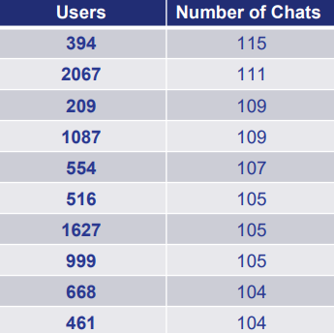
From our chat graph analysis, what further exploration should we undertake?
In the last part, the Chat Graph Analysis is achieved byNeo4J.
The CSV data files of “chatdata ”are loaded into Neo4J. Then we firstly find the top 10 chattiest users by matching all users with a Create Chat edge, return the users’ ID and the count of the users.

Slide 10
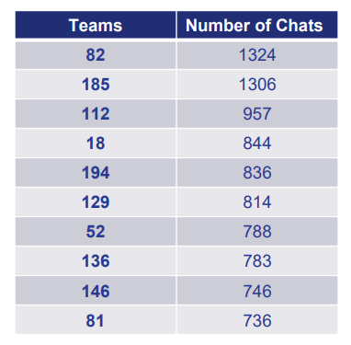
Secondly, we find the top 10 chattiest teams by matching all Chat Items with a part of edge connecting them with a TeamChatSession node and the TeamChatSession nodes must have an Owned By edge connecting them with any other node, and return the count of teams as well.

Slide 11
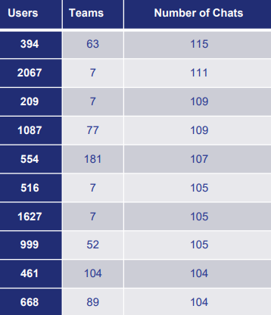
● According to the first two tables, we get the third table which identifies among the top 10 chattiest users, one of them belongs to chattiest teams, i.e. the user “999” belongs to the team “52”, but other 9 users are not part of the top 10 chattiest teams. This states that most of the chattiest users are not in the chattiest teams.

Slide 12
Recommendation
● Following previous results, here are some recommendations to be considered:
● Offer more products to iPhone users. According to the decision tree classification, it reflects that most users which on the platform iPhone are High Rollers, so offering more products to them can increase our revenue.
● Provide more products to “high level spending user", which is similar as the first one, but the users are not totally identical. Thanks to Clustering results, we know that the “high level spending user” clicked less but buy more than others, we can provide more products to them for increasing the revenue.
● Provide some fixed pay packages or promotion to users, especially to “low level spending user". This action can stimulate consumption of users, and since the paying probability of “low level spending user” is low, the promotion can encourage them to purchase.
Notes:
From your own viewpoint, make one recommendation/action the Eglence should follow to improve their business. Be sure to explain your rationale.

